Slide 1
Classroom Management
Methods, Approaches and Behavior that favor the establishment of a positive learning climate in the classroom
Peter HOFMANN, LIMINA, Austria

Slide 2
Content of the course
Module 1
Introduction to participants
Background of the project “Best Performers”
Self-Assessment on Classroom Management
Pedagogical relationships
Module 2
What happened since last module
Pedagogical relationships cont.
Shaming – as an aspect of dysfunctional pedagogical relationships

Slide 3
Content of the course
Module 3
What happened since last module
Physical learning environment
Presentation of the project “We make school” from the NMS Leipziger Platz in Vienna
Module 4
What happened since last module
Group Dynamic in the classroom
Revisiting the contents of the whole course
Evaluation of the course

Slide 4
Classroom Management – our understanding
Physical learning environment
Approaches, methods and behaviour that favour the establishment of a positive learning climate
Pedagogical relationships
Group Dynamic

Slide 5
Classroom Management – Self Assessment
Step 1: Work through the Self-Assessment Worksheet by yourself
Step 2: Write a short summary focusing on the two questions:
What do I do already that works well?
Where would I like to improve and look for suggestions and activities?
Step 3: Write your answers into www.menti.com (enter the code xxxxxx)
You have 30 minutes for all of this!

Slide 6
Pedagogical relationships
Think a moment of a teacher you had who you have still a positive memory of, who inspired you, who you liked?
What did she/he well?
People are relationship creatures by nature!
Learning happens largely through and in relationships!

Slide 7
Pedagogical relationships
Pedagogical relationship:
institutional role + personal dimension
Qualities needed in the relationship:
Recognizing and respecting the value of each individual.
Appreciating the individual abilities, strengths and efforts.
Recognizing the basic human rights of children and youth.

Slide 8
Pedagogical relationships
Advantages of a high quality pedagogical relationship
For teachers
Joy and satisfaction in their work
Less exhaustion or even burnout
For Pupils
Higher motivation to learn
More lasting learning results

Slide 9
Pedagogical relationship - Essay
We invite you to write a short essay based on the following three questions:
The pedagogical relationship I want to live with my pupils looks like this….
What supports me already realizing this?
What hinders me realizing this?
Please send the essay to Email until xx.yy.zz

Slide 10
Thank you for your active participation!
We meet again for Module 2
Date of Module 2

Slide 11
Classroom Management Module 2
Methods, Approaches and Behavior that favor the establishment of a positive learning climate in the classroom
Peter HOFMANN, LIMINA, Austria

Slide 12
Content of Module 2
Module 2
What happened since last module
Pedagogical relationships cont.
Shaming – as an aspect of dysfunctional pedagogical relationships

Slide 13
Pedagogical relationship – Summary of the essays

Slide 14
Pedagogical relationship – Summary of the essays

Slide 15
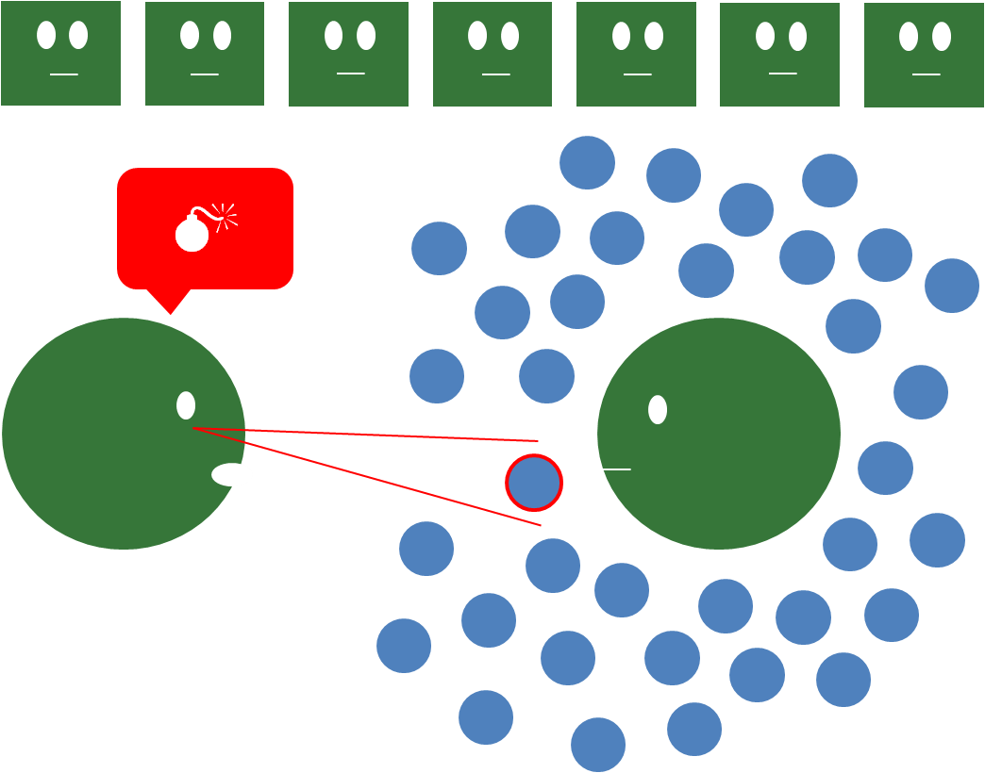
Shaming – as an expression of a dysfunctional pedagogical relationship
What is shaming about?
Shaming comes from an external source
Something I consider a weakness of mine becomes made visible in front of other people whose opinion is important to me

Slide 16
Shaming – as an expression of a dysfunctional pedagogical relationship
What is shaming about?
Social pressure that wants conformity and adaptation
The relational context is systemic and hierarchical
Physiologically it is similar a panic attack – blockage, feels like being disabled.
The impact on an individual depends on the social background, internalized norms and expectations and resilience.
Very often it is not intentional.

Slide 17
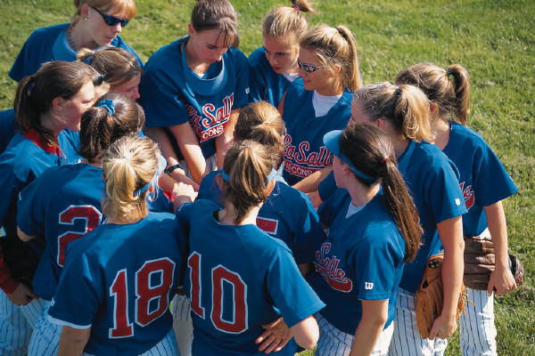
Breakout Session
Get together in trios in the chatrooms
One after the other shares a shaming experiences in educational contexts - situations they have experienced themselves or witnessed.
10 minutes per person!

Slide 18
Shaming – as an expression of a dysfunctional pedagogical relationship
Can shaming be avoided?
„We can not avoid that people are bing shamed. [...] But we can change ourselves and learn to deal with people in a way that they feel appreciated and respected.“ (Smutny 2011)

Slide 19
Shaming – as an expression of a dysfunctional pedagogical relationship
What helps to avoid shaming?
Respecting the worth of every human being
A healthy pedagogical relationship
Seeing the strengths as well as the weaknesses
Differentiation between action and person
Being self-aware

Slide 20
Thank you for your active participation!
We meet again for Module 3
Date of Module 3

Slide 21
Classroom Management Module 3
Methods, Approaches and Behavior that favor the establishment of a positive learning climate in the classroom
Peter HOFMANN, LIMINA, Austria

Slide 22
Content of Module 3
Module 3
What happened since last module
Physical learning environment
Presentation of the project “We make school” from the NMS Leipziger Platz in Vienna

Slide 23
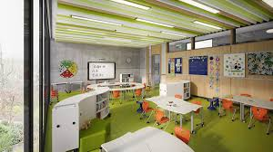
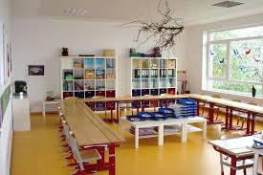
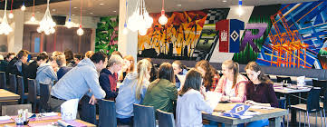
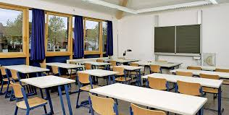
Physical learning environment

Slide 24
Breakout Session
Get together in fours in the chatrooms
Group Discussion: What are small interventions every teacher can do to improve the physical learning environment?
20 minutes!

Slide 25
Individual reflection
What do I want to do in future to improve the physical learning environment in my class?
10 minutes!

Slide 26
Thank you for your active participation!
We meet again for Module 4
Date of Module 4

Slide 27
Classroom Management Module 4
Methods, Approaches and Behavior that favor the establishment of a positive learning climate in the classroom
Peter HOFMANN, LIMINA, Austria

Slide 28
Content of Module 4
Module 4
What happened since last module
Group Dynamic in the classroom
Revisiting the contents of the whole course
Evaluation of the course

Slide 29
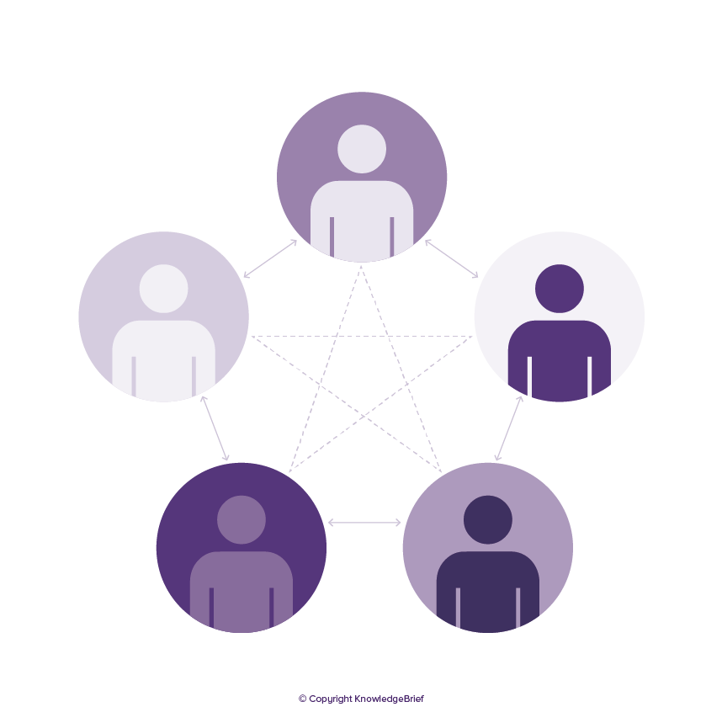
Group Dynamic in school classes
.
Group dynamics is a set of behavioral and psychological processes that occur within a social group or between groups

Slide 30
Group Dynamics in school classes
.
Activities at the beginning
Making pupils active shapers of group dynamics
Group dynamics in school classes
Good spaces to discuss conflicts and reflect dynamics
Setting up group “rules”

Slide 31
Breakout Session
Get together in fours in the chatrooms
Small groups discuss cases they have brought with challenging group dynamic situations - collecting different measures to intervene into group dynamic.
Write the measures in the chat.
30 minutes!

Slide 32
Content of the course
Module 1
Introduction to participants
Background of the project “Best Performers”
Self-Assessment on Classroom Management
Pedagogical relationships
Module 2
What happened since last module
Pedagogical relationships cont.
Shaming – as an aspect of dysfunctional pedagogical relationships

Slide 33
Content of the course
Module 3
What happened since last module
Physical learning environment
Presentation of the project “We make school” from the NMS Leipziger Platz in Vienna
Module 4
What happened since last module
Group Dynamic in the classroom
Revisiting the contents of the whole course
Evaluation of the course

Slide 34
Individual reflection
What am I taking into my teaching practice? What are my next concrete steps when it comes to my classroom management?
Write one or two steps into the chat!
20 minutes!

Slide 35
Thank you for your active participation! We wish you all the best for your further pedagogical work!

