Slide 1
Leadership
For teachers and headteachers

Slide 2
Overview
Leadership
Human resource development
Leadership for teachers and headteachers
Burn out as a health risk for teachers
Creating health-promoting working conditions
Feedback in class

Slide 3
Leadership for teachers and headteachers
Why leadership? For overpassing barriers to learning!

Slide 4
Why Leadership?
School leadership, like classroom teaching, is a complex process and managing complexity is, in itself, inherently stressful.
It is stressful because it entails influencing others so that they might strive to improve and thrive in different ways; and improvement involves change.

Slide 5
Which dimensions of leadership?
In phases of change, the quality of leadership culture becomes particularly evident. Great school management means involving teaching staff in change processes from the very beginning.
Successful school leaders know that there are associations between the quality of classroom teaching and the quality of student learning and achievement. Teachers may respond positively or negatively in the presence of challenging circumstances, and this will depend on the quality of organizational or colleague leadership as well as the strength of their own commitment.

Slide 6
Which dimensions of leadership?
Here some examples for leaders’ actions that you can pick inside the handbook:
Positive connections (e.g. promote caring and consistent relationships with supportive adults and peers; diversify teaching approaches by encompassing multiple intelligences)
Set clear, consistent, and appropriate boundaries (e.g. share behavioral expectations with staff, students, families; base rules and policies on research, information gathering, and best practices as “best performers ones”)
Teach life guiding skills (e.g. integrate life skills into daily school activities; survey your school’s educational workforce about what they think they need in the way of professional development initiatives)
Provide Nurture and support (e.g. provide purposeful and regular feedback that sends message of support; work with the media to get stories that demonstrate caring and support out of the public)
Set and communicate purposes and expectations (e.g. permeate the school with “can do” messages; tell stories about Role models)
Provide opportunities for meaningful participation (e.g. promote team planning and team teaching; promote student participation in school governance)

Slide 7
Creating health-promoting working conditions
Leading people by creating a healthy, happy, safe school

Slide 8
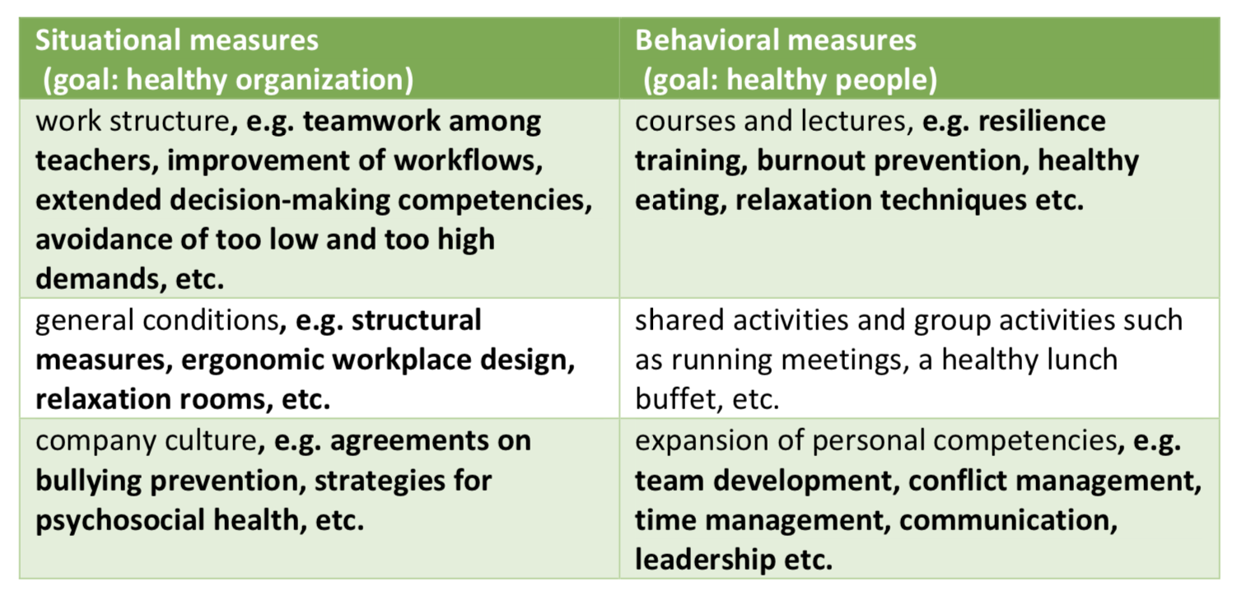
Leading healthy and happy organizations
Healthy and happy people, as well as, school workers, live in healthy and happy organizations. Examples of measures You can implement the following situational and behavioral prevention measures at your school:

Slide 9
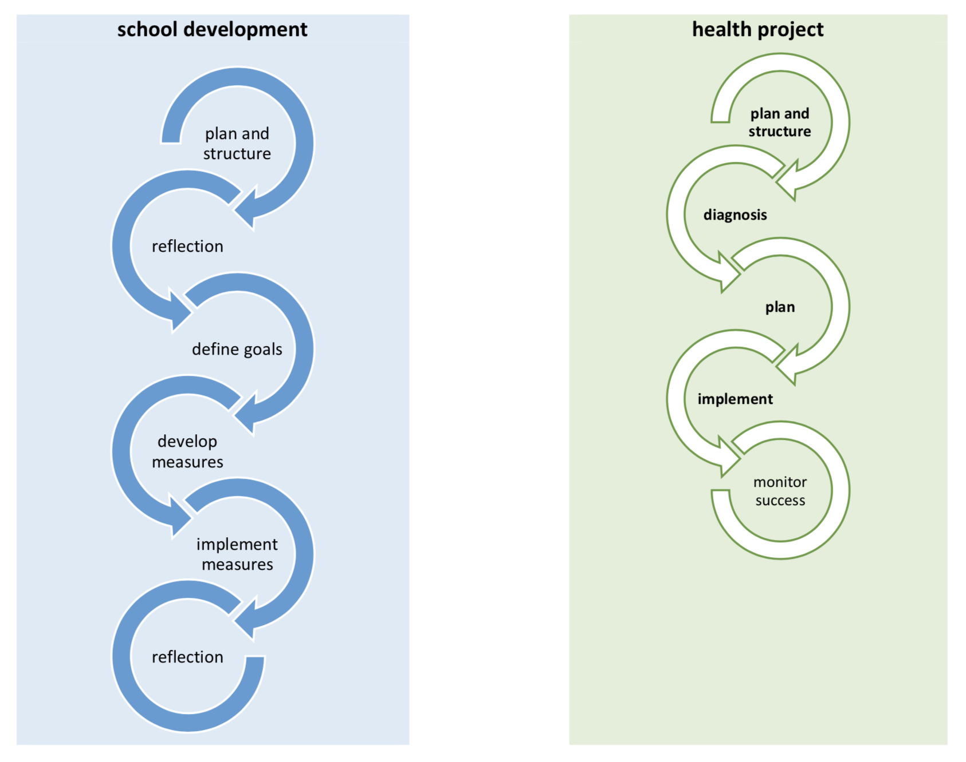
Leading healthy schools: compare school development and health project development

Slide 10
Leading healthy schools
The process of developing health projects is similar to that of school development projects.
In both cases, it is important that you create a suitable structure first by installing a steering group:
Diagnosis
Plan
Implementation
Monitoring success

Slide 11
Diagnosis
The aim is to assess the current need for a health project by collecting important information through various tools and summarizing the results in a report. The diagnosis should also make it possible to measure the effects of the health project (“before and after” comparison). The following instruments are available: Conversations with teachers and/or students, health trainings for teachers and/or students, structured health surveys or sick leave evaluations.

Slide 12
Plan
The specific steps are planned in this phase. Moderated health groups (5 to 7 people) are suitable for this purpose. In these groups, staff members can develop detailed proposals of measures for the steering group. This should be followed by a moderated workshop, in which the school management and staff participate. Again, an action plan as described in the chapter on school development can be used as a tool to plan the individual steps of implementation.

Slide 13
Implementation
In accordance with the needs and plans previously identified, measures of situational and behavioral prevention are now implemented in a structured manner using project management tools.

Slide 14
Monitoring success
After a health project is implemented it must be evaluated and documented. The project results are clearly summarized and evaluated in a final report. The aim is to anchor the topic of health sustainably in schools. This turns a temporary project into a program that is an integral part of school culture. A health survey, interviews, recording of group processes, etc. are great tools for monitoring success.

Slide 15
Successful parent involvement
In many interviews, teachers mentioned that they miss the parents as educational partners. Parents have a large influence on their children's attitude towards school as well as their educational career decisions. Therefore, it is important that teachers and parents are “on the same page” when it comes to the education of children. What can parents contribute and how can parents be motivated?
Close cooperation between the following parties can strengthen the educational triangle:
Triangolo p. 36

Slide 16
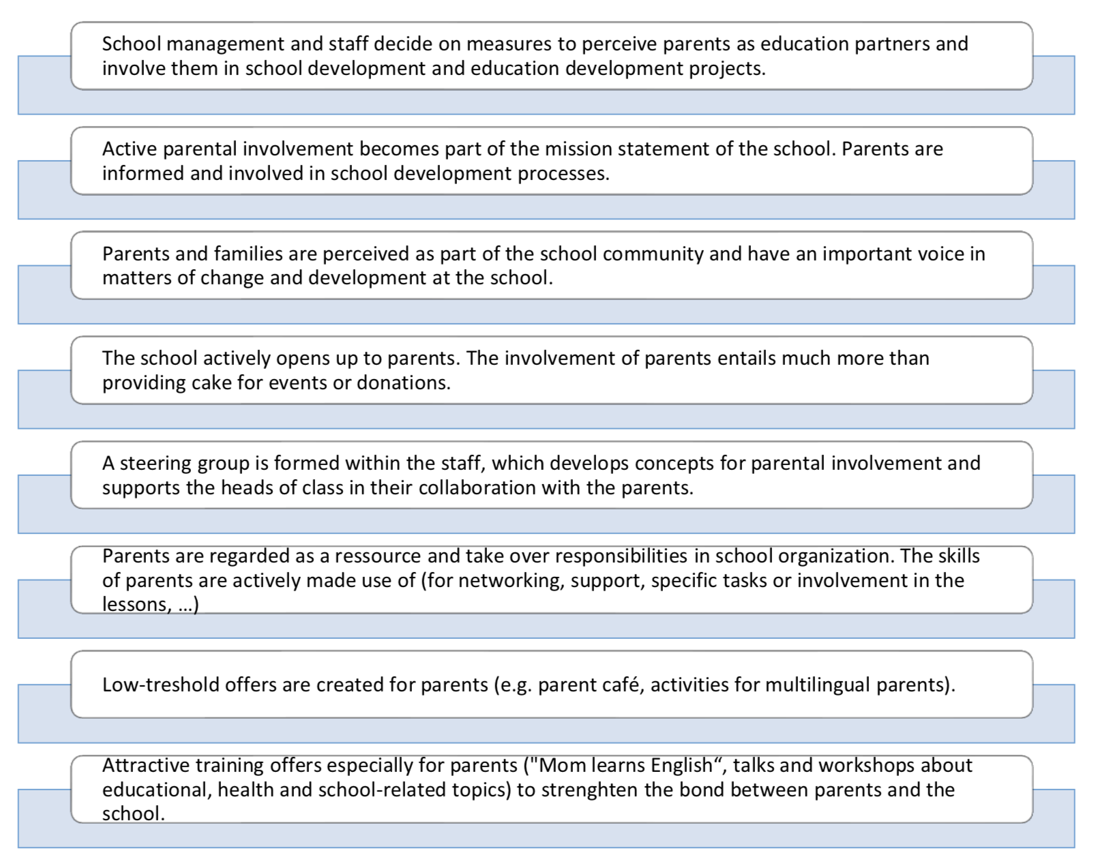
Favorable conditions for parental work
What framework conditions can we create to increase parental involvement?

Slide 17

Write a short report for leading an healthy and happy school
Write a short report (2 pages) on the following questions:
What changes does your school need to become more healthy?
Which dimensions of leadership could support this transformation?
  Planning health projects?
  Implementing teaching strategies for life skills in daily school?
  Involving parents and families?

Slide 18
Create healthy spaces for students but also for teachers, and other school workers/stakeholders
When listing resources, pay attention to dimensions of leadership:
  Positive connections
  Set clear, consistent, and appropriate boundaries
  Teach life guiding skills
  Provide Nurture and support
  Set and communicate purposes and expectations
  Provide opportunities for meaningful participation
Create a list of resources for an healthy space in your school. What is present, what could be implemented and trasformed?

Slide 19

Get feedback to your example for creating an healthy space and improve it
Present your example of a healthy space to a colleague and get her/his feedback.
If possible, improve your previous work on the basis of the feedback.

Slide 20

Get familiar with the Feedback in class
«Nothing motivates more than success»
More and more schools are discovering constructive feedback as a central element of creating a motivating school culture. Students (but also teachers) can be informed about their current level of knowledge and encouraged to achieve new and better results through appropriate feedback
Make yourself familiar for feedback in class
How can you support students by consciously commenting on negative performance in an external, variable and specific manner?
For example: "This time (specific) you were not well prepared enough for these questions (external) (variable). Therefore, this time I couldn’t give you a good grade.

Slide 21
Practice how to provide nurture and support
Form an exercise group with three other colleagues and practice together:
Vulnerable situations during which students need support
Vulnerable situations during which teachers need support

Slide 22

Design a workshop
Please design a workshop for your colleagues to work on how to support people in achieving their goals and coping learning/teaching situations
When designing this workshop, use the previous suggestion for creating healthy spaces inside or outside the classroom where nurture and support could be enhanced

Slide 23
Human resource development
Coping with health risks for teachers

Slide 24
Human resource development
Change does not always come easy. In organizations - and schools are organizations – some employees can build up great resistance. This can render the management of a change process considerably more difficult. Change requires the capabilty of managing stress and could become an opportunity for leading people towards a better healthy workstyle
In our interviews, principals have repeatedly presented us with a model that they like to use as an introduction to performance reviews and staff meetings:
Support for change processes – the comfort zone model as a method for changes

Slide 25
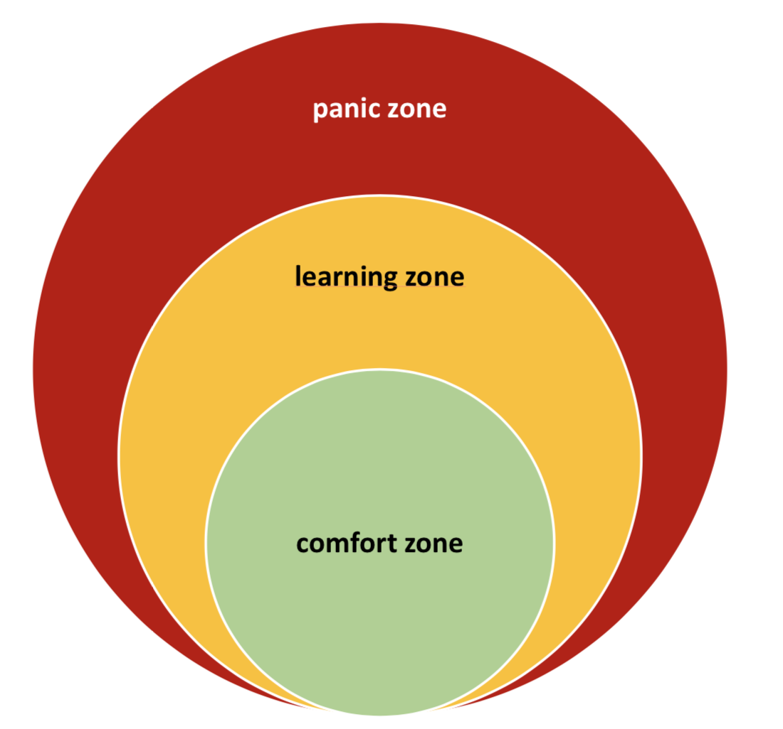
The sections of the comfort zone model
The comfort zone model distinguishes three sections in the process of change:

Slide 26
The comfort zone
Every person has their comfort zone in which they feel content and can accomplish their tasks confidently and routinely, since they are aware of their own strengths and abilities. Outside of this comfort zone begins the unknown, with new tasks and responsibilities beyond the familiar boundaries. That's why leaving the comfort zone usually causes unease; your employees have to overcome themselves – and many of them struggle with doubts or fears of failure.

Slide 27
The learning zone
In this borderland between comfort zone and new challenges lies the learning zone: here you have the chance to grow, to learn and to make new experiences. If these experiences are positive and your employees are able to meet the challenges, their comfort zone increases. However, if they advance too far or if they want too much too fast, the risk of failure increases.

Slide 28
The Panic zone
In the panic zone lies everything that cannot be mastered, that can no longer be controlled. Risk and danger become overpowering, therefore learning is no longer possible. When failure is experienced in this zone, employees usually withdraw back into their comfort zone and even increase its boundaries. It will then become much more difficult to motivate employees to make a new attempt.

Slide 29
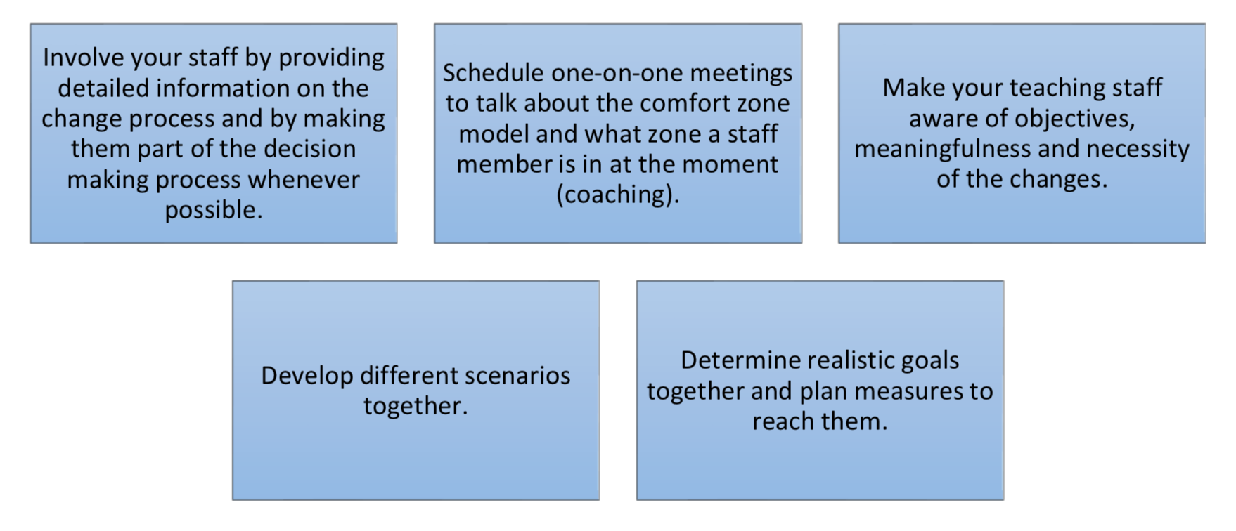
Ways out of the comfort zone

Slide 30
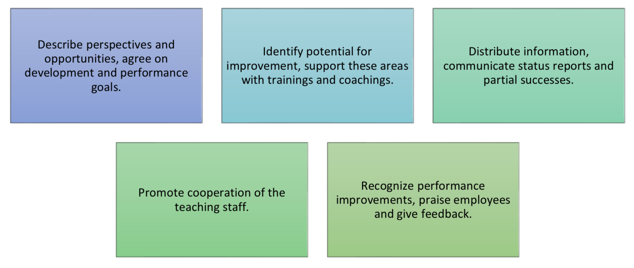
Everything is better together: providing support in the learning zone

Slide 31
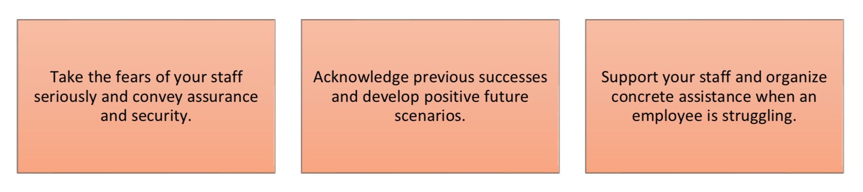
Don´t panic...! First aid in the panic zone

Slide 32
Burn out: leading and empowering teachers at risk
Burnout develops slowly over months and years due to continuous physical, emotional and mental exertion and ends with the physical, mental, psychological and social collapse of those affected.
The main symptoms of burnout are physical and emotional exhaustion, persistent lack of physical and mental performance and motivation and the increasing inability to recover. In some cases, phases of improvement and recovery are followed by further phases of deterioration. Unfortunately, burnout is often not detected in time because the transition from normal exhaustion to the first stages of burnout often go unnoticed and are perceived as normal development.

Slide 33
Re-Read and consider the Leaders‘ actions again
Positive connections (e.g. promote caring and consistent relationships with supportive adults and peers; diversify teaching approaches by encompassing multiple intelligences)
Set clear, consistent, and appropriate boundaries (e.g. share behavioral expectations with staff, students, families; base rules and policies on research, information gathering, and best practices as “best performers ones”)
Teach life guiding skills (e.g. integrate life skills into daily school activities; survey your school’s educational workforce about what they think they need in the way of professional development initiatives)
Provide Nurture and support (e.g. provide purposeful and regular feedback that sends message of support; work with the media to get stories that demonstrate caring and support out of the public)
Set and communicate purposes and expectations (e.g. permeate the school with “can do” messages; tell stories about Role models)
Provide opportunities for meaningful participation (e.g. promote team planning and team teaching; promote student participation in school governance)

Slide 34
Get familiar with different methods
Make yourself familiar with the best performers methods in the database. If necessary you can also look at the handbook
Select one method for each Leader‘s action described before (Positive connections; Set clear, consistent, and appropriate boundaries; Teach life guiding skills; Provide Nurture and support; Set and communicate purposes and expectations; Provide opportunities for meaningful participation).
Take note of Best performers examples in a list

Slide 35
Shift Leaders‘ method in your reality
Form an exercise group with three other colleagues and discuss your list taking note of:
How much do you like these methods
How much do you feel comfortable in applying that method
Do you think you could practice these methods in your schools?

Slide 36
Get familiar with leadership dimensions and try to use the groupwork feedback on your list for leading healthy and happy schools
Select a leadership dimension and develop a plan for implementing it

Slide 37
A draft for professional development in leadership dimensions
Introduce your plan for promoting leadership for healthy and resilient schools
Describe needs and resources (Diagnosis)
Describe goals (Plan)
Describe actions (Implementation)
Describe how you can assess the project (Monitoring success)

