Slide 1
School Culture
Methods of organizational development that favor a beneficial school culture

Slide 2
Overview
School Culture
Mission Statement
Principles and explanations
Developing a mission statement together
Feedback culture - learning from each other
Organizational Development
Key points for creating a mission statement for your school
The Johari window
Feedback guide for working groups

Slide 3
Organizational development
Why organizational development? Because change is necessary!

Slide 4
Why organizational development?
Schools are changing more than ever. New technologies, social developments as well as constantly evolving basic conditions influence the educational system on a daily basis. School management and staff have to find suitable measures to deal with the everchanging demands placed on teaching.

Slide 5
Why organizational development?
In phases of change, the quality of leadership culture becomes particularly evident. Great school management means involving teaching staff in change processes from the very beginning. Therefore, it is essential to make all measures as transparent as possible. The teaching staff must be informed about how, when and to what extent they will be affected by upcoming changes. You can only count on the support and cooperation of your employees if you involve them in all phases of the process.

Slide 6
Why organizational development?
In order to be able to react adequately to changes, everyone working at the school needs a structure that provides support and clear orientation in uncertain times. A mission statement can serve as a guiding principle and provide orientation.

Slide 7
The mission statement
The mission statement as a foundation for successful school development

Slide 8
The mission statement
Successful schools are based on a strong vision that teachers have developed together with the school management. Due to the rapid changes in modern society, these visions also need to be kept up to date. Therefore, an existing mission statement should be updated and adapted at least every ten years.

Slide 9
The mission statement
A mission statement is basically a self-description of an organization created by its employees. As a guide for the entire school organization, it aligns the actions of all school employees with common goals. The mission statement is public and accessible for outsiders. All parties involved have to experience the outlined statements in daily school life. It reflects the school’s self-image and thus promotes identification with one's own school. The general pedagogic goals of the school also need to be outlined in the mission statement as a commitment towards students, parents and subsequent institutions that are part of the educational system.

Slide 10
The mission statement
A mission statement is a standard tool for evaluating the performance of the school management and staff. Through the development of a mission statement, the school organization can be managed and improved in a goal-oriented way.

Slide 11
Principles and explanations
The guiding principles form the core of a mission statement. They refer to values, goals and success criteria, determine the relationship between all parties involved and define the specific competencies of the school. Guiding principles are simple statements of one or two sentences. The explanation section then provides further details. The guiding principles must meet certain criteria in order to define realistic and understandable visions.

Slide 12
Developing a mission statement together
considerations | description
essential | Are the statements essential for the school?
universal | Are the principles general enough?
long-term | Do they have a long-term perspective?
comprehensive | Do they provide a complete picture of the school?
achievable | Are the principles feasible?
clear | Are they easily comprehensible?

Slide 13
When phrasing the statement, pay attention to
criteria for writing
meaningful phrasing
short and simple sentences
honest statements
objective, accurate and future-oriented wording
direct speech
consistent style

Slide 14
Key points for creating a mission statement for your school
values:
clients:
What do we stand for?
Who are our students?
identity and mission:
Who are we?
What is our chosen and/or school-specific mission?
What values determine our actions?
Who are our target groups and cooperation partners?

Slide 15
Key points for creating a mission statement for your school
skills:
services:
What are our assets?
What expertise do we have?
What are our strenghths?
What do we offer?
Which special services can we provide?
general organizational goals:
What is our organization's purpose?
What are our goals in general?

Slide 16
Key points for creating a mission statement for your school
definition of successful learning:
What does successful learning mean to us?
ressources:
From what do we draw our strenghth?
Which special ressources are available for our work?
What ressources can we rely on?

Slide 17
Write a short report on profound changes
Write a short report (2 pages) on the following questions:
What profound changes have happened at your school in the last 10 years?
How have these changes affected
you?
your employees?
your students?

Slide 18
Create an example mission statement
Create an example mission statement for your own school. Pay attentention to the following considerations:
essential
universal
long-term
comprehensive
achievable
clear
When phrasing the statement, pay attention to:
meaningful phrasing
short and simple sentences
honest statements
objective, accurate and future-oriented wording
direct speech
consistent style

Slide 19
Get feedback to your example mission statement and improve it
Present your example of a mission statement to a colleague and get her/his feedback.
If possible, improve your previous work on the basis of the feedback.

Slide 20
Get familiar with the Metaplan techniques
Make yourself familiar with the following two methods in our Methods Database:
The Metaplan technique – the process
The Metaplan technique – the card method

Slide 21
Practice the Metaplan techniques
Form an exercise group with three other colleagues and practice together:
The Metaplan technique – the process
The Metaplan technique – the card method

Slide 22
Design a workshop
Please design a workshop for your colleagues to work on a common mission statement for your school.
When designing this workshop, use the following two methods from our Methods Database:
The Metaplan technique – the process
The Metaplan technique – the card method

Slide 23
Feedback culture
Learning from each other

Slide 24
Feedback culture
If you want to implement sustainable changes in your school, an active feedback culture is indispensable. It promotes constructive cooperation and exploring new paths together in order to find innovative solutions at the school.

Slide 25
Feedback culture
Many people view feedback as a more or less elegant way to criticize another person. "How can I tell my conversation partner something negative without her/him feeling offended?"
However, feedback is more than a skillful technique for politely expressing criticism. In companies and organizations, it is a constructive means of learning from one another, gaining new insights and thus making sustainable changes in daily operations possible.
People usually leave their comfort zone when giving feedback and, even more so, when receiving it. They immediately enter their learning zone, in which they can grow and make new experiences.

Slide 26
The Johari window
You can make use of this instrument to illustrate the potential of an active feedback culture at your school.
The Johari window is a proven technique to improve group dynamics. It consists of 4 quadrants:

Slide 27
The Johari window - How individuals and whole schools can benefit from feedback:
 | familiar to me | unknown to me
Known to others | Open | Blind spot
Unknown to others | Hidden | Unknown
others tell me about me
I give away

Slide 28
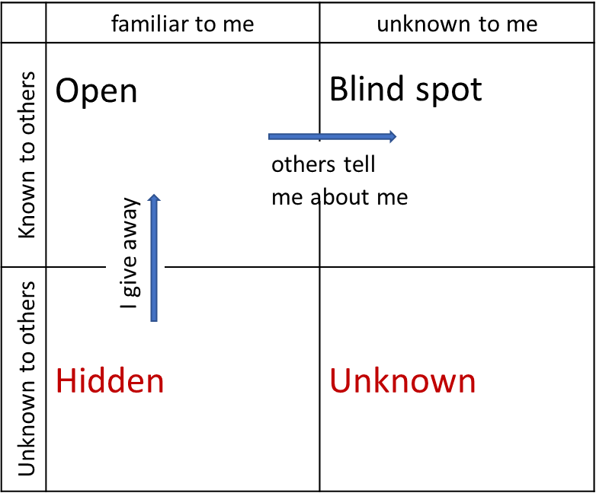
Open
Everything a person reveals to others, in other words: the aspects of one’s personality that are made visible to the outside world and are perceived by others. These include
external characteristics such as appearance, manners or physical reactions,
as well as personal qualities such as ambition or anxiety, as far as they can be perceived by others and
points of view and attitudes such as religious, moral and ethical beliefs.
This part of the "window" is usually rather small compared to the other parts as mainly unconscious factors determine interactions between people.

Slide 29
Hidden
This quadrant contains everything that the person knows - in other words, what they are aware of, but either unknowingly do not show to others or hide consciously from them.

Slide 30
Blind spot
This part includes everything that the subject is unaware of although it is perceived by others. They recognize behaviors and characteristics in the person that she or he does not notice. Through feedback from other people, information can be transported from the “blind spot” to the "open" quadrant.

Slide 31
Unknown
This aspect refers to everything that is not perceived by the subject or others.

Slide 32
Expand your “Open-Field“
Joseph Luft, one of the developers of the Johari window, states one goal of learning in group dynamics is to increase the common scope of action and make it more transparent. Consequently, the upper left field in the Johari window should expand, while the other three quadrants shrink.

Slide 33
2 strategies
Both strategies complement each other and help us make the unconscious conscious and therefore manageable.
revealing oneself
communicating observations
When sharing and communicating motives, experiences and thoughts, we reduce the necessary effort of concealing things from others.
This gives us more freedom and scope for action in the public.
When communicating our observations on blind spots directly to others (feedback), they immediately gain knowledge about themselves!
This gives them the opportunity to become more aware of and use their private and public scope for action.

Slide 34
Feedback as a steering instrument for working groups, teams and groups
As with individuals, feedback can also be used in organizations to
clarify ambiguities
render processes transparent or conscious,
counteract certain tendencies, discuss fears and anxieties
uncover old myths about the school, which have become established over time and stand in the way of change.
In short: Whenever we are working towards reducing the blind spot of an organization and thus increasing the scope for action of all parties.

Slide 35
Feedback guide for working groups, teams and groups
A certain structure of feedback rounds is necessary so the whole team can have learning experiences in the sense of a learning organization. Thereby, the focus lies on two main areas:
recognize and appreciate proven methods
identify need for change

Slide 36
Feedback guide for working groups, teams and groups
Feedback rounds always require a neutral moderator who oversees the structure and compliance with the rules. A team member can take over this task, ideally a different person should assume the role at each meeting.

Slide 37
Get familiar with different feedback methods
Make yourself familiar with the feedback methods described in our Guidebook for Schools (page 20 – 22).

Slide 38
Practice different feedback techniques
Form an exercise group with three other colleagues and practice together:
Sociometric differentiation exercises
Flash
Personal query
Barometer of opinions

Slide 39
Get familiar with a feedback method to use in working groups
Make yourself familiar with the Feedback guide for working groups, teams and groups described in our Guidebook for Schools (page 19).

Slide 40
Moderate a feedback round
Introduce the topic feedback to your colleagues by explaining the Johari window.
Organize a feedback session and use the feedback guide for groups.

