Slide 1
Teaching/Learning Strategies

Slide 2
Overview
topic
Effects of class composition and school organization mechanisms
Feedback in class
Class structure and design of learning spaces
Helpful Attributions
Class composition and timetable design

Slide 3
Class structure and design of learning spaces
subtitle

Slide 4
Class structure and design of learning spaces
Our research process brought us in contact with schools that are breaking new grounds both in the structuring of their classes and of learning times. When deciding how to divide students into classes, a strong focus lies on creating a heterogeneous environment to avoid negative effects of class composition.

Slide 5
Effects of class composition and school organization mechanisms
Effects of class composition stem from the social or socioeconomic as well as the linguistic and ethnic backgrounds of the students. As a teacher, you know about the effects of having many children with weak socioeconomic background in a class that lacks strong learners as role models. Researchers are trying to analyze how the complex interplay of socioeconomic background, support from home, students' and teachers' expectations, attitudes and ascriptions (in terms of students' performance and willingness to learn) creates certain effects that in turn affect the learning outcomes and motivation of the class and individual students.

Slide 6
Effects of class composition and school organization mechanisms

Slide 7
Effects of class composition and school organization mechanisms
The school can influence the composition of the classes in order to mitigate expected negative tendencies and facilitate positive synergies. If necessary, school management can assign more experienced teachers to the classes that face particular challenges.
In the following, we describe how a school can implement new approaches in teaching through class composition and timetable structure:

Slide 8
class composition and timetable structure

Slide 9
Dividing students into classes in third school week
Students are assigned to classes only after they have gotten to know each other better. Therefore, all students spend the first two weeks of school together in a large group. This large group is supervised by a permanent team of teachers. The aim is to give student an idea about who they would like to be in a class with and to give teachers the chance to observe the students in order to decide later on how divide them into classes. To this end, students go through a varied program that allows them to get to know each other in many different situations. The teachers make sure that the large group of students is divided into smaller groups on different occasions, so students meet as many others as possible. The agenda consists, among others, of the following activities:

Slide 10
Dividing students into classes in third school week

Slide 11
Dividing students into classes in third school week
At the end of these two weeks, each student writes the names of two students they would like to be in a class with on a piece of paper. The school management promises to take these into account and guarantees every student will be in a class which at least one of the mentioned persons.

Slide 12
Make yourself familiar with different methods you can use for creating „days of getting to know each other“ for your students
Search our methods database for the following activies:
Coffee Morning (concentric circles)
Speech Chain

Slide 13
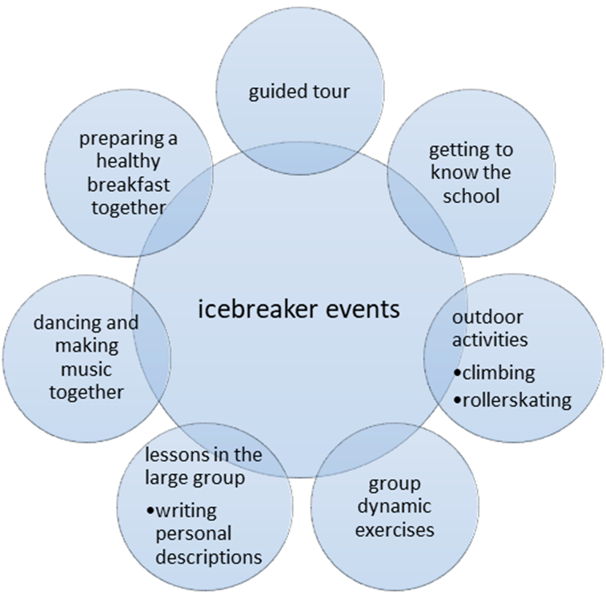
Create icebreaker events for new classes in your school
Use the “icebreaker events-model” and add activies that are missing.
Create for each icebreaker event a detailed description.
Put together a program for students by putting the exercises you have described into a temporal structure that makes sense for you. You can choose how long these days of getting to know each other should last.

Slide 14
Feedback in class
Providing helpful feedback using attribution theory

Slide 15
Feedback in class
More and more schools are discovering constructive feedback as a central element of creating a motivating school culture. Students can be informed about their current level of knowledge and encouraged to achieve new and better results through appropriate feedback.
Celebrating small successes with the students and setting individual and realistic goals together has proved to have a positive impact. Students need to know what they are already good at and which areas they need to improve. In the long run however, they also need to learn to assess their capacities and willingness to perform themselves. When a student fails, it’s a teachers’ job to reassure her or him that, with the appropriate effort, things will go better next time.

Slide 16
Feedback in class
In order to reach the required learning goals, it is advisable to take small steps to be able to perceive and celebrate partial successes. For weaker students it is often helpful to notice and acknowledge even very small improvements.
But what are the aforementioned attribution theories and how can they be applied in class?

Slide 17
Helpful Attributions
Attributions in the sense of psychological attribution theories are assumptions people make in order to explain the reasons behind the behaviour of other people or - which is particularly important in this context - their own behaviour. The concept of attribution theory can be traced back to the social psychologist Fritz Heider, who distinguished between external and internal attribution. The extension of Heider’s model by Martin Seligman is discussed here in particular, as his model is especially well suited to support students who lack motivation due to school failure.

Slide 18
internal / external - variable / stable
Internal / external attributes: Success or failure can be attributed either to one's own person (internal) or to circumstances (external). The student sees herself/himself either as a "master" of her/his fate or as a helpless "victim" of uncontrollable powers.
Variable / stable attributes: The second dimension of attribution is the stability of explanatory factors. The reason for a behavior can either be effective for a long time (e.g. intelligence) or it can occur on short notice (e.g. current mood). In both internal and external attribution, students can make assumptions about whether their case is a fixed fact (stable) or a changeable cause (variable).

Slide 19
internal / external - variable / stable
If we combine the dimensions internally/externally with the factors variable/stable, the result is the following four-field scheme:
 | internally | externally
stable | skills, ability | difficulty level of a task
variable | effort, will | luck, fortune

Slide 20
global / specific attributes:
The third dimension refers to the range of the cause. A cause is global if it has the same effect in different situations ("It will affect everything that comes."), while it is specific if limited to a certain situation ("It will only have an effect on that specific situation.").

Slide 21
internal / external - variable / stable - global / specific
Combining the above four-field scheme with the factors global/specific leads to the following classification:
 | internal+stable | internal+variable | external+stable | external+variable
global | general ability or inability. | general commitment, diligence, effort | general external requirements | happiness, bad luck (in)favorable circumstances in general
specific | necessary skill for a particular job | commitment, diligence, effort in a certain situation | certain requirements in a specific situation | happiness and bad luck in a certain situation

Slide 22
How can a student explain a failed exam?
 | internal+stable | internal+variable | external+stable | external+variable
global | I'm incapable of passing exams. | I never study enough. | Teachers always ask too much. | I had bad luck and got difficult questions.
specific | The subject matter was too difficult for me. | I didn't study enough for this exam. | This teacher is too demanding. | I was not prepared for these questions.

Slide 23
Use of attribution theory in teaching
Teachers have an influence on the conclusions and assessments their students come to about themselves through the way they comment on their students' successes and failures. Depending on the style of attribution they use, they can help to ensure that especially weaker students either remain motivated and continue to try, or begin to withdraw more and more from school life and its requirements.

Slide 24
Explanations that lead to depression
According to Seligman, a certain style of attribution can lead to depression, namely to explain negative experiences through internal, stable and general causes:
internal
Students think they are the problem, not external circumstances.
stable
The problem is perceived as unchangeable and non-variable.
general
Students view the problem as omnipresent, not specific to certain situations.

Slide 25
Explanations that lead to megalomania
The opposite, namely evaluating negative experiences as external, variable and specific, can lead to not assuming responsibility for one’s own mistakes and consequently not having any learning experiences.
To use the words of Heckhausen, an expert in the field of motivational psychology: "If you ALWAYS attribute good experiences to INTERNAL and bad experiences to EXTERNAL, you may suffer from megalomania!”

Slide 26
General recommendations? Take into account the thinking styles of your students!
For these reasons, general recommendations cannot be given.
However, it has proven quite useful to refer individually to each students' personal attributions and include the results in the evaluations of their school performance.
Students who show a tendency towards the attributions internal/stable/general need help to modify their thinking patterns. As a teacher, you can support those students by consciously commenting on negative performance in an external, variable and specific manner, for example: "This time (specific) you were not well prepared enough for these questions (external) (variable). Therefore, this time I couldn’t give you a good grade."

Slide 27
General recommendations? Take into account the thinking styles of your students!
Students who show a tendency towards the attributions external/variable/specific often do not seem to assume any personal responsibility for failures. Firstly, you should question whether this reaction could be a defense mechanism to protect themselves. You can clarify how the student really feels about the failure and what kind of support she or he needs in a one-to-one conversation.

Slide 28
Practice Helpful Attributions!
How do your students usually explain successes and how do they explain failures? Take the list of students of one of your classes and think about how each student typically explains personal failures in school to herself/himself and how she/he explains personal school successes to herself/himself by making use of the six-field scheme.

Slide 29
Practice Helpful Attributions!
Now find those students who need your help to succeed at school and consider helpful and supportive feedback for them for the following situations.
school failures
school successes
Make again use of the six-field scheme.

Slide 30
Practice Helpful Attributions with a colleague!
Describe to your colleague how one of the students you want to support with Helpful Attributions typically explains his/her school failures and successes to himself/herself and then suggest appropriate feedback for this student.
Get feedback from your collegue on your planned Helpful Attributions.
In this way, discuss each student on your list with your collegue. Then swap roles and give your colleague feedback on his planned Helpful Attributions.

